Slide 1
Writing and Deploying Spark Applications
Chapter 16

Slide 2
Writing and Deployinga Spark Application
In this chapter you will learn
How to write a Spark Application
How to run a Spark Application or the Spark Shell on a YARN cluster
How to access and use the Spark Application Web UI
How to configure application properties and logging

Slide 3
Chapter Topics
Writing and Deploying a Spark Application
Spark Applications vs. Spark Shell
Creating the SparkContext
Building a Spark Application (Scala and Java)
Running a Spark Application
The Spark Application Web UI
Hands-On Exercise: Write and Run a Spark Application
Configuring Spark Properties
Logging
Essential Points
Hands-On Exercise: Configure a Spark Application

Slide 4
Spark Shell vs. Spark Applications
The Spark Shell allows interactive exploration and manipulation of data
REPL using Python or Scala
Spark applications run as independent programs
Python, Scala, or Java
For jobs such as ETL processing, Streaming, and so on

Slide 5
Chapter Topics
Writing and Deploying a Spark Application
Spark Applications vs. Spark Shell
Creating the SparkContext
Building a Spark Application (Scala and Java)
Running a Spark Application
The Spark Application Web UI
Hands-On Exercise: Write and Run a Spark Application
Configuring Spark Properties
Logging
Essential Points
Hands-On Exercise: Configure a Spark Application

Slide 6
The SparkContext
Every Spark program needs a SparkContext
The interactive shell creates one for you
In your own Spark application you create your own SparkContext
Named sc by convention
Call sc.stop when program terminates

Slide 7


Scala Example: WordCount
import org.apache.spark.SparkContext import org.apache.spark.SparkContext._
object WordCount {
def main(args: Array[String]) { if (args.length < 1) {
System.err.println("Usage: WordCount <file>")
System.exit(1)
}
val sc = new SparkContext()
val counts = sc.textFile(args(0)). flatMap(line => line.split("\\W")). map(word => (word,1)).reduceByKey(_ + _)
counts.take(5).foreach(println)
sc.stop()
}
}

Slide 8
Chapter Topics
Writing and Deploying a Spark Application
Spark Applications vs. Spark Shell
Creating the SparkContext
Building a Spark Application (Scala and Java)
Running a Spark Application
The Spark Application Web UI
Hands-On Exercise: Write and Run a Spark Application
Configuring Spark Properties
Logging
Essential Points
Hands-On Exercise: Configure a Spark Application

Slide 9
Building a Spark Application: Scala or Java
Scala or Java Spark applications must be compiled and assembled into JAR files
JAR file will be passed to worker nodes
Apache Maven is a popular build tool
For specific setting recommendations, see http://spark.apache.org/docs/latest/building- with-maven.html
Build details will differ depending on
Version of Hadoop (HDFS)
Deployment platform (Spark Standalone, YARN, Mesos)
Consider using an IDE
IntelliJ or Eclipse are two popular examples
Can run Spark locally in a debugger
15-10

Slide 10
Chapter Topics
Writing and Deploying a Spark Application
Spark Applications vs. Spark Shell
Creating the SparkContext
Building a Spark Application (Scala and Java)
Running a Spark Application
The Spark Application Web UI
Hands-On Exercise: Write and Run a Spark Application
Configuring Spark Properties
Logging
Essential Points
Hands-On Exercise: Configure a Spark Application

Slide 11




Running a Spark Application
The easiest way to run a Spark Application is using the spark-submit
script
$ spark-submit WordCount.py fileURL
Python
$ spark-submit --class WordCount \ MyJarFile.jar fileURL
Scala/Java

Slide 12
Spark Application Cluster Options
Spark can run
Locally
– No distributed processing
Locally with multiple worker threads
On a cluster
Local mode is useful for development and testing
Production use is almost always on a cluster

Slide 13
Supported Cluster Resource Managers
Hadoop YARN
Included in CDH
Most common for production sites
Allows sharing cluster resources with other applications (for example, MapReduce, Impala)
Spark Standalone
Included with Spark
Easy to install and run
Limited configurability and scalability
Useful for testing, development, or small systems
Apache Mesos
First platform supported by Spark
Now used less often

Slide 14


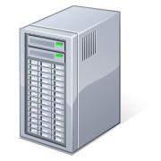








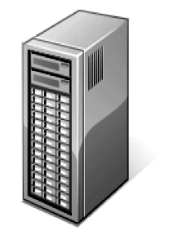



How Spark Runs on YARN: Client Mode (1)
NodeManager
DataNode
Driver Program
Spark Context
Executor
NodeManager
DataNode
Executor
Executor
Name Node
Resource Manager
NodeManager
DataNode
Application Master 1
NodeManager
DataNode

Slide 15
How Spark Runs on YARN: Client Mode (2)
NodeManager
DataNode
Driver Program
Spark Context
Executor
NodeManager
DataNode
Executor
Executor
Name Node
Resource Manager
NodeManager
DataNode
Application Master 1
NodeManager
DataNode

Slide 16



How Spark Runs on YARN: Client Mode (3)
NodeManager
DataNode
Driver Program
Spark Context
Executor
NodeManager
DataNode
Executor
Executor
Name Node
Resource Manager
NodeManager
DataNode
Application Master 1
Executor
Driver Program
Spark Context
NodeManager
DataNode
Executor
Application Master 2

Slide 17
How Spark Runs on YARN: Client Mode (4)
NodeManager
DataNode
Driver Program
Spark Context
Executor
NodeManager
DataNode
Executor
Executor
Name Node
Resource Manager
NodeManager
DataNode
Application Master 1
Executor
Driver Program
Spark Context
NodeManager
DataNode
Executor
Application Master 2

Slide 18




How Spark Runs on YARN: Cluster Mode (1)
NodeManager
DataNode
Executor
NodeManager
DataNode
submit
Executor
Executor
Name Node
Resource Manager
Node_{A}M_{pp}an_{lic}a_{a}g_{t}e_{io}r _{n Master} DataNode
Driver Program
Spark Context
NodeManager
DataNode

Slide 19
How Spark Runs on YARN: Cluster Mode (2)
NodeManager
DataNode
Executor
NodeManager
DataNode
submit
Executor
Executor
Name Node
Resource Manager
Node_{A}M_{pp}an_{lic}a_{a}g_{t}e_{io}r _{n Master} DataNode
Driver Program
Spark Context
NodeManager
DataNode
15-20

Slide 20



Running a Spark Application Locally
Use spark-submit
Local options
local[*] – run locally with as many threads as cores (default)
local[n] – run locally with n threads
local – run locally with a single thread
--master to specify cluster option
$ spark-submit --master 'local[3]' \ WordCount.py fileURL
Python
$ spark-submit --master 'local[3]' --class \ WordCount MyJarFile.jar fileURL
Scala/ Java

Slide 21




Running a Spark Application on a Cluster
Use spark-submit
Cluster options
yarn-client
yarn-cluster
spark://masternode:port (Spark Standalone)
mesos://masternode:port (Mesos)
--master to specify cluster option
$ spark-submit --master yarn-cluster \ WordCount.py fileURL
Python
$ spark-submit --master yarn-cluster --class \ WordCount MyJarFile.jar fileURL
Scala/ Java

Slide 22



Starting the Spark Shell on a Cluster
The Spark Shell can also be run on a cluster
Pyspark and spark-shell both have a --master
yarn (client mode only)
Spark or Mesos cluster manager URL
option
local[*] – run with as many threads as cores (default)
local[n] – run locally with n worker threads
local – run locally without distributed processing
$ pyspark --master yarn
Python
$ spark-shell --master yarn
Scala

Slide 23
Options when Submittinga Spark Application to a Cluster
Some other spark-submit options for clusters
--jars – additional JAR files (Scala and Java only)
--py-files – additional Python files (Python only)
--driver-java-options – parameters to pass to the driver JVM
--executor-memory – memory per executor (e.g., 1000m, 2g)
--packages -- Maven coordinates of an external library to include
Plus several YARN-specific options
--num-executors – the number of executors to start
--queue – the YARN queue to submit the application to
Show all available options
--help

Slide 24
Chapter Topics
Writing and Deploying a Spark Application
Spark Applications vs. Spark Shell
Creating the SparkContext
Building a Spark Application (Scala and Java)
Running a Spark Application
The Spark Application Web UI
Hands-On Exercise: Write and Run a Spark Application
Configuring Spark Properties
Logging
Essential Points
Hands-On Exercise: Configure a Spark Application

Slide 25

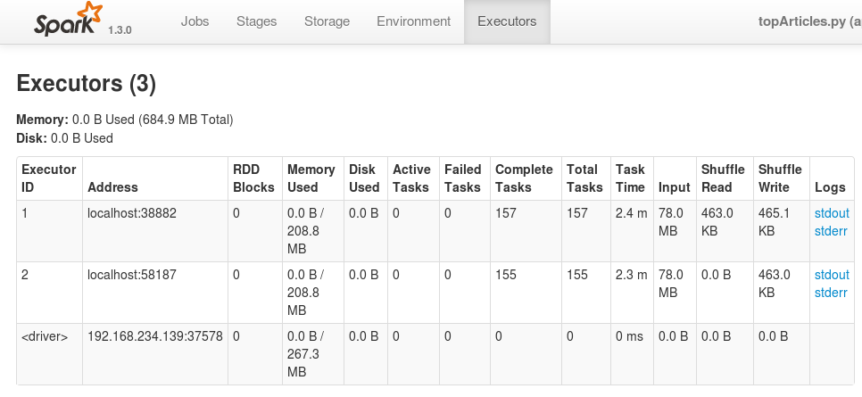




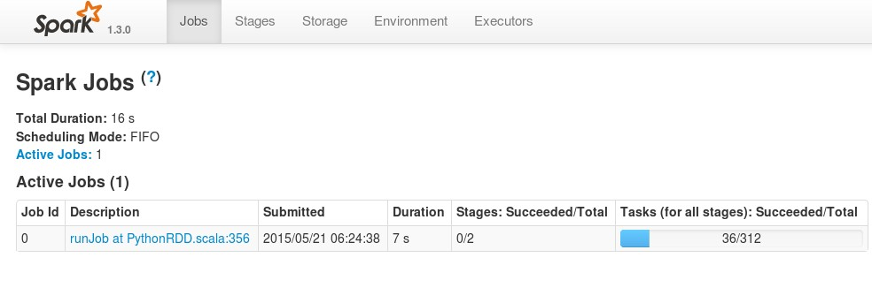
The Spark Application Web UI
The Spark UI lets you monitor running jobs, and view statistics and configuration

Slide 26

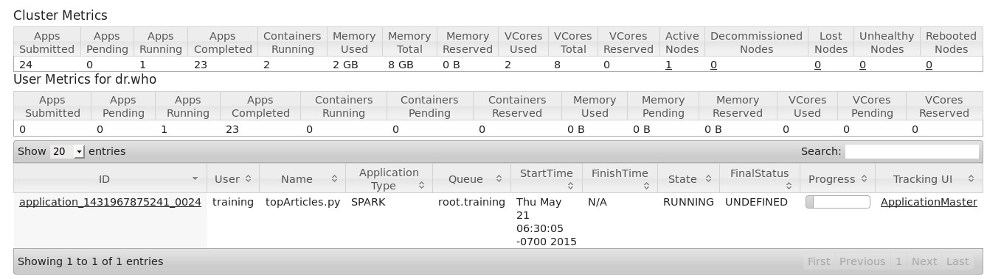

Accessing the Spark UI
The Web UI is run by the Spark drivers
When running locally: http://localhost:4040
When running on a cluster, use the cluster UI, for example, YARN UI

Slide 27

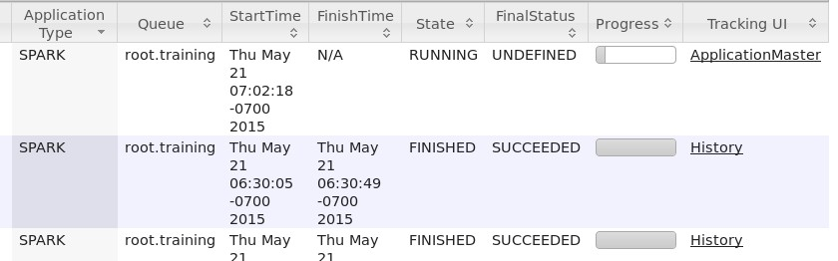

Viewing Spark Job History (1)
Viewing Spark Job History
Spark UI is only available while the application is running
Use Spark History Server to view metrics for a completed application
Optional Spark component
Accessing the History Server
For local jobs, access by URL
For example, localhost:18080
For YARN Jobs, click History link in YARN UI

Slide 28

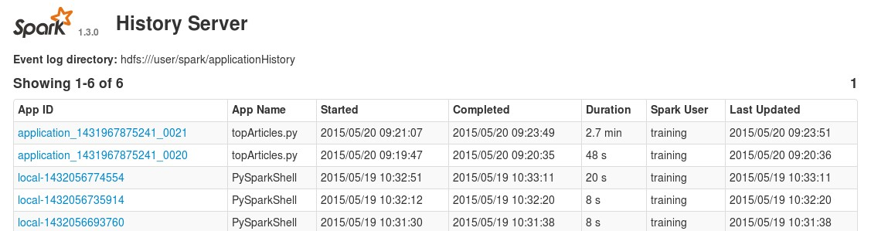
Viewing Spark Job History (2)
Spark History Server

Slide 29
Chapter Topics
Writing and Deploying a Spark Application
Spark Applications vs. Spark Shell
Creating the SparkContext
Building a Spark Application (Scala and Java)
Running a Spark Application
The Spark Application Web UI
Hands-On Exercise: Write and Run a Spark Application
Configuring Spark Properties
Logging
Essential Points
Hands-On Exercise: Configure a Spark Application
15-30

Slide 30

Building and Running Scala Applicationsin the Hands-On Exercises
Basic Maven projects are provided in the
exercises/projects directory with two packages
stubs – starter Scala file, do exercises here
solution – final exercise solution
Project Directory Structure
$ mvn package
$ spark-submit \
--class stubs.CountJPGs \ target/countjpgs-1.0.jar \ weblogs.*
+countjpgs
-pom.xml
+src
+main
+scala
+solution
-CountJPGs.scala
+stubs
-CountJPGs.scala
+target
-countjpgs-1.0.jar

Slide 31
Hands-On Exercise: Write and Run a Spark Application
In this exercise you will
Write a Spark application to count JPG requests in a web server log
If you choose to use Scala, compile and package the application in a JAR file
Run the application locally to test
Submit the application to run on the YARN cluster
Please refer to the Hands-On Exercise Manual

Slide 32
Chapter Topics
Writing and Deploying a Spark Application
Spark Applications vs. Spark Shell
Creating the SparkContext
Building a Spark Application (Scala and Java)
Running a Spark Application
The Spark Application Web UI
Hands-On Exercise: Write and Run a Spark Application
Configuring Spark Properties
Logging
Essential Points
Hands-On Exercise: Configure a Spark Application

Slide 33
Spark Application Configuration
Spark provides numerous properties for configuring your application
Some example properties
spark.master
spark.app.name
spark.local.dir – where to store local files such as shuffle output (default /tmp)
spark.ui.port – port to run the Spark Application UI (default
4040)
spark.executor.memory – how much memory to allocate to each Executor
And many more...
– See Spark Configuration page for more details

Slide 34
Spark Application Configuration
Spark Applications can be configured
Declaratively or
Programmatically

Slide 35


Declarative Configuration Options
spark-submit
script
– For example, spark-submit --driver-memory
Properties file
– Tab- or space-separated list of properties and values
500M
Load with spark-submit
Example:
--properties-file
filename
spark.master spark://masternode:7077 spark.local.dir /tmp
spark.ui.port 4444
Site defaults properties file
$SPARK_HOME/conf/spark-defaults.conf
Template file provided

Slide 36
Setting Configuration Properties Programmatically
Spark configuration settings are part of the SparkContext
Configure using a SparkConf object
Some example functions
setAppName(name)
setMaster(master)
set(property-name, value)
set functions return a SparkConf object to support chaining

Slide 37

SparkConf Example (Python)
import sys
from pyspark import SparkContext from pyspark import SparkConf
if name == " main ": if len(sys.argv) < 2:
print >> sys.stderr, "Usage: exit(-1)
WordCount
<file>"
sconf = SparkConf()
.setAppName("Word
\ Count") \
.set("spark.ui.port","4141") sc = SparkContext(conf=sconf)
counts = sc.textFile(sys.argv[1]) \
.flatMap(lambda line: line.split()) \
.map(lambda w: (w,1)) \
.reduceByKey(lambda v1,v2: v1+v2)
for pair in counts.take(5): print pair

Slide 38


SparkConf Example (Scala)
import import import
org.apache.spark.SparkContext org.apache.spark.SparkContext._ org.apache.spark.SparkConf
object WordCount {
def main(args: Array[String]) {
if (args.length < 1) { System.err.println("Usage: WordCount System.exit(1)
}
<file>")
val sconf = new SparkConf()
.setAppName("Word Count")
.set("spark.ui.port","4141") val sc = new SparkContext(sconf)
val counts = sc.textFile(args(0)). flatMap(line => line.split("\\W")).
map(word => (word,1)).
reduceByKey(_ + _) counts.take(5).foreach(println)
}
}

Slide 39
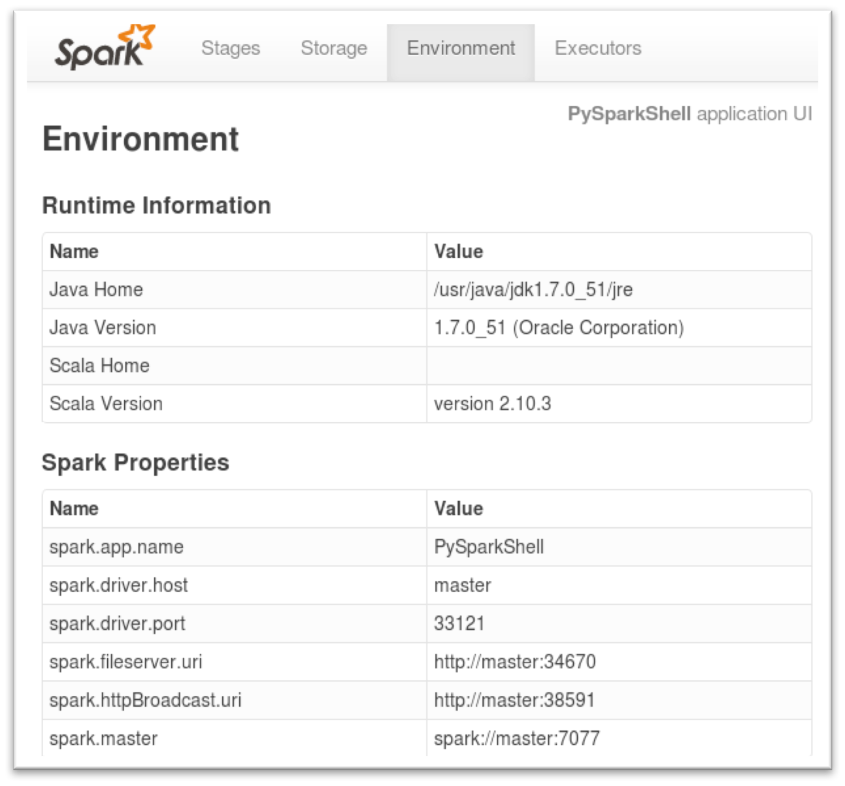

Viewing Spark Properties
You can view the Spark property setting in the Spark Application UI
15-40

Slide 40
Chapter Topics
Writing and Deploying a Spark Application
Spark Applications vs. Spark Shell
Creating the SparkContext
Building a Spark Application (Scala and Java)
Running a Spark Application
The Spark Application Web UI
Hands-On Exercise: Write and Run a Spark Application
Configuring Spark Properties
Logging
Essential Points
Hands-On Exercise: Configure a Spark Application

Slide 41
Spark Logging
Spark uses Apache Log4j for logging
Allows for controlling logging at runtime using a properties file
– Enable or disable logging, set logging levels, select output destination
For more info see http://logging.apache.org/log4j/1.2/
Log4j provides several logging levels
FATAL
ERROR
WARN
INFO
DEBUG
TRACE
OFF

Slide 42


Spark Log Files (1)
Log file locations depend on your cluster management platform
YARN
If log aggregation off, logs are stored locally on each worker node
If log aggregation is on, logs are stored in HDFS
Default /var/log/hadoop-yarn
Access via yarn logs command or YARN RM UI
$ yarn application -list
Application-Id Application-Name Application-Type… application_1441395433148_0003 Spark shell SPARK … application_1441395433148_0001 myapp.jar MAPREDUCE …
$ yarn logs -applicationId <appid>
…

Slide 43
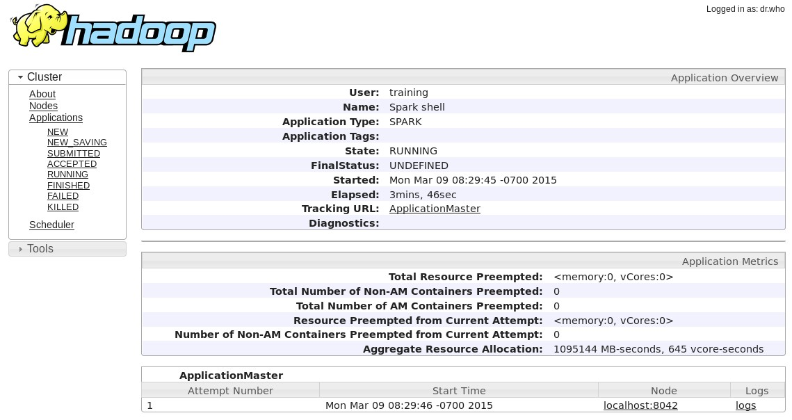
Spark Log Files (2)

Slide 44

Configuring Spark Logging (1)
Logging levels can be set for the cluster, for individual applications, or even for specific components or subsystems
Default for machine: $SPARK_HOME/conf/log4j.properties
– Start by copying log4j.properties.template
log4j.properties.template
 | # Set everything to be logged to the console log4j.rootCategory=INFO, console log4j.appender.console=org.apache.log4j.ConsoleAppende r log4j.appender.console.target=System.err …

Slide 45
Configuring Spark Logging (2)
Spark will use the first log4j.properties file it finds in the Java classpath
Spark Shell will read log4j.properties from the current directory
– Copy log4j.properties to the working directory and edit
…my-working-directory/log4j.properties
 | # Set everything to be logged to the console log4j.rootCategory=DEBUG, console log4j.appender.console=org.apache.log4j.ConsoleAppende r log4j.appender.console.target=System.err …

Slide 46
Chapter Topics
Writing and Deploying a Spark Application
Spark Applications vs. Spark Shell
Creating the SparkContext
Building a Spark Application (Scala and Java)
Running a Spark Application
The Spark Application Web UI
Hands-On Exercise: Write and Run a Spark Application
Configuring Spark Properties
Logging
Essential Points
Hands-On Exercise: Configure a Spark Application

Slide 47
Essential Points (1)
Use the Spark Shell application for interactive data exploration
Write a Spark application to run independently
Spark applications require a Spark Context object
Spark applications are run using the spark-submit
script
Spark configuration parameters can be set at runtime using the
spark-submit script or programmatically using a SparkConf object
Spark uses log4j for logging
– Configure using a log4j.properties file

Slide 48
Essential Points (2)
Spark is designed to run on a cluster
Spark includes a basic cluster management platform called Spark Standalone
Can also run on Hadoop YARN and Mesos
The master distributes tasks to individual workers in the cluster
Tasks run in executors – JVMs running on worker nodes
Spark clusters work closely with HDFS
Tasks are assigned to workers where the data is physically stored when possible

Slide 49
Chapter Topics
Writing and Deploying a Spark Application
Spark Applications vs. Spark Shell
Creating the SparkContext
Building a Spark Application (Scala and Java)
Running a Spark Application
The Spark Application Web UI
Hands-On Exercise: Write and Run a Spark Application
Configuring Spark Properties
Logging
Essential Points
Hands-On Exercise: Configure a Spark Application
15-50

Slide 50
Hands-On Exercise: Configure Spark Applications
In this exercise you will
Set properties using spark-submit
Set properties in a properties file
Change the logging levels in a log4j.properties file
Please refer to the Hands-On Exercise Manual
15-51

Slide 51
Parallel Processing
Chapter 17

Slide 52
Parallel Processing in Spark
In this chapter you will learn
How RDDs are distributed across a cluster
How Spark executes RDD operations in parallel
16-2

Slide 53
Chapter Topics
Parallel Processing in Spark
Review: Spark on a Cluster
RDD Partitions
Partitioning of File-Based RDDs
HDFS and Data Locality
Executing Parallel Operations
Stages and Tasks
Essential Points
Hands-On Exercise: View Jobs and Stages in the Spark Application UI

Slide 54



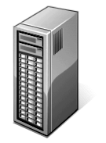

Spark Cluster Review
Worker Nodes
$ spark-submit
--master yarn-client
--class MyClass
--num-executors 3 MyApp.jar
Cluster Master Node
HDFS
Master Node

Slide 55
Spark Cluster Review
Worker Nodes
$ spark-submit
Container
--m
--c
--n
aster yarn-clie lass MyClass
um-executors 3 App.jar
nt
Driver Program Spark Context
My
Container
Cluster Master Node
HDFS
Master Node
Container

Slide 56
Spark Cluster Review
Worker Nodes
Container
$ spark-submit
Executor
--m
--c
--n
aster yarn-clie lass MyClass
um-executors 3 App.jar
nt
Driver Program Spark Context
My
Container
Executor
Cluster Master Node
HDFS
Master Node
Container
Executor

Slide 57
Chapter Topics
Parallel Processing in Spark
Review: Spark on a Cluster
RDD Partitions
Partitioning of File-Based RDDs
HDFS and Data Locality
Executing Parallel Operations
Stages and Tasks
Essential Points
Hands-On Exercise: View Jobs and Stages in the Spark Application UI

Slide 58


RDDs on a Cluster
Resilient Distributed Datasets
Data is partitioned across worker nodes
Partitioning is done automatically by Spark
Optionally, you can control how many partitions are created
RDD 1
Executor
rdd_1_0
Executor
rdd_1_1
Executor
rdd_1_2

Slide 59
Chapter Topics
Parallel Processing in Spark
Review: Spark on a Cluster
RDD Partitions
Partitioning of File-Based RDDs
HDFS and Data Locality
Executing Parallel Operations
Stages and Tasks
Essential Points
Hands-On Exercise: View Jobs and Stages in the Spark Application UI

Slide 60





File Partitioning: Single Files
Partitions from single files
– Partitions based on size
sc.textFile("myfile",3)
You can optionally specify a minimum number of partitions
textFile(file, minPartitions)
Default is 2
More partitions = more parallelization
RDD
Executor
Executor
Executor
16-10

Slide 61









File Partitioning: Multiple Files
RDD
Executor
sc.textFile("mydir/*")
Each file becomes (at least) one partition
File-based operations can be done per-partition, for example parsing XML
sc.wholeTextFiles("mydir")
For many small files
Creates a key-value PairRDD
key = file name
value = file contents
Executor
Executor
RDD
Executor
Executor

Slide 62
Operating on Partitions
Most RDD operations work on each element of an RDD
A few work on each partition
foreachPartition – call a function for each partition
mapPartitions – create a new RDD by executing a function on each partition in the current RDD
mapPartitionsWithIndex – same as mapPartitions but includes index of the partition
Functions for partition operations take iterators

Slide 63
Chapter Topics
Parallel Processing in Spark
Review: Spark on a Cluster
RDD Partitions
Partitioning of File-Based RDDs
HDFS and Data Locality
Executing Parallel Operations
Stages and Tasks
Essential Points
Hands-On Exercise: View Jobs and Stages in the Spark Application UI

Slide 64

HDFS and Data Locality (1)

Slide 65








HDFS and Data Locality (2)
$ hdfs dfs –put mydata
HDFS
Block 1
HDFS
Block 2
HDFS
Block 3

Slide 66
HDFS and Data Locality (3)
Driver Program
Spark Context
Executor
HDFS
Block 1
Executor
HDFS
Block 2
Executor
HDFS
Block 3
Executor

Slide 67



HDFS and Data Locality (4)
sc.textFile("hdfs://…mydata").collect()
By default, Spark partitions file-based RDDs by block.
Each block loads into a single partition.
RDD
Driver Program
Spark Context
Executor
HDFS
Block 1
Executor
HDFS
Block 2
Executor
HDFS
Block 3
Executor

Slide 68






HDFS and Data Locality (5)
sc.textFile("hdfs://…mydata").collect()
An action triggers execution: tasks on executors load data from blocks into partitions
RDD
Driver Program
Spark Context
Executor
task
HDFS
Block 1
Executor
task
HDFS
Block 2
Executor
task
HDFS
Block 3
Executor

Slide 69
HDFS and Data Locality (6)
sc.textFile("hdfs://…mydata").collect()
Data is distributed across executors until an action returns a value to the driver
RDD
Driver Program
Spark Context
Executor
HDFS
Block 1
Executor
HDFS
Block 2
Executor
HDFS
Block 3
Executor

Slide 70
Chapter Topics
Parallel Processing in Spark
Review: Spark on a Cluster
RDD Partitions
Partitioning of File-Based RDDs
HDFS and Data Locality
Executing Parallel Operations
Stages and Tasks
Essential Points
Hands-On Exercise: View Jobs and Stages in the Spark Application UI
16-20

Slide 71
Parallel Operations on Partitions
RDD operations are executed in parallel on each partition
When possible, tasks execute on the worker nodes where the data is in memory
Some operations preserve partitioning
For example, map, flatMap, filter
Some operations repartition
For example, reduce, sort, group

Slide 72

Example: Average Word Length by Letter (1)
> avglens = sc.textFile(file)
RDD

Slide 73

Example: Average Word Length by Letter (2)
> avglens = sc.textFile(file) \
.flatMap(lambda line: line.split())
RDD
RDD

Slide 74
Example: Average Word Length by Letter (3)
> avglens = sc.textFile(file) \
.flatMap(lambda line: line.split()) \
.map(lambda word: (word[0],len(word)))
RDD
RDD
RDD

Slide 75
Example: Average Word Length by Letter (4)
> avglens = sc.textFile(file) \
.flatMap(lambda line: line.split()) \
.map(lambda word: (word[0],len(word))) \
.groupByKey()
RDD
RDD
RDD
RDD

Slide 76


Example: Average Word Length by Letter (5)
> avglens = sc.textFile(file) \
.flatMap(lambda line: line.split()) \
.map(lambda word: (word[0],len(word))) \
.groupByKey() \
.map(lambda (k, values): \ (k, sum(values)/len(values)))
RDD
RDD
RDD
RDD
RDD

Slide 77
Chapter Topics
Parallel Processing in Spark
Review: Spark on a Cluster
RDD Partitions
Partitioning of File-Based RDDs
HDFS and Data Locality
Executing Parallel Operations
Stages and Tasks
Essential Points
Hands-On Exercise: View Jobs and Stages in the Spark Application UI

Slide 78
Stages
Operations that can run on the same partition are executed in stages
Tasks within a stage are pipelined together
Developers should be aware of stages to improve performance

Slide 79




Spark Execution: Stages (1)
> val avglens = sc.textFile(myfile). flatMap(line => line.split("\\W")). map(word => (word(0),word.length)). groupByKey().
map(pair => (pair._1, pair._2.sum/pair._2.size.toDouble))
> avglens.saveAsTextFile("avglen-output")
Stage 1
Stage 2
RDD
RDD
RDD
RDD
RDD

Slide 80
Spark Execution: Stages (2)
> val avglens = sc.textFile(myfile). flatMap(line => line.split("\\W")). map(word => (word(0),word.length)). groupByKey().
map(pair => (pair._1, pair._2.sum/pair._2.size.toDouble))
> avglens.saveAsTextFile("avglen-output")
Stage 1
Stage 2
Task 1
Task 5
Task 2
Task 3
Task 6
Task 4
16-30

Slide 81
Spark Execution: Stages (3)
> val avglens = sc.textFile(myfile). flatMap(line => line.split("\\W")). map(word => (word(0),word.length)). groupByKey().
map(pair => (pair._1, pair._2.sum/pair._2.size.toDouble))
> avglens.saveAsTextFile("avglen-output")
Stage 1
Stage 2
Task 1
Task 2
Task 3
Task 4
Task 5
Task 6

Slide 82
Spark Execution: Stages (4)
> val avglens = sc.textFile(myfile). flatMap(line => line.split("\\W")). map(word => (word(0),word.length)). groupByKey().
map(pair => (pair._1, pair._2.sum/pair._2.size.toDouble))
> avglens.saveAsTextFile("avglen-output")
Stage 1
Stage 2
Task 1
Task 2
Task 3
Task 4
Task 5
Task 6

Slide 83












Summary of Spark Terminology
Job – a set of tasks executed as a result of an action
Stage – a set of tasks in a job that can be executed in parallel
Task – an individual unit of work sent to one executor
Application – can contain any number of jobs managed by a single driver
Task
Job
Stage
RDD
RDD
RDD
RDD
RDD
Stage

Slide 84
How Spark Calculates Stages
Spark constructs a DAG (Directed Acyclic Graph) of RDD dependencies
Narrow dependencies
Only one child depends on the RDD
No shuffle required between nodes
Can be collapsed into a single stage
Examples: map, filter, union
Wide (or shuffle) dependencies
Multiple children depend on the RDD
Defines a new stage
Examples: reduceByKey, join, groupByKey

Slide 85






Viewing the Stages using toDebugString (Scala)
> val avglens = sc.textFile(myfile). flatMap(line => line.split("\\W")). map(word => (word(0),word.length)). groupByKey().
map(pair => (pair._1, pair._2.sum/pair._2.size.toDouble))
> avglens.toDebugString()
(2) MappedRDD[5] at map at …
| ShuffledRDD[4] at groupByKey at …
+-(4) MappedRDD[3] at map at …
Stage 2
| FlatMappedRDD[2] at flatMap at …
| myfile MappedRDD[1] at textFile at …
| myfile HadoopRDD[0] at textFile at …
Stage 1
Indents indicate stages (shuffle boundaries)

Slide 86












Spark Task Execution (1)
val avglens = sc.textFile(myfile). flatMap(line => line.split("\\W")). map(word => (word(0),word.length)). groupByKey().
map(pair => (pair._1, pair._2.sum/pair._2.size.toDouble))
avglens.saveAsTextFile("avglen-output")
Stage 1
Stage 2
Task 1
Task 2
Task 3
Task 4
Task 5
Task 6
Executor
HDFS
Block 1
Executor
HDFS
Block 2
Driver Program
Spark Context
Executor
HDFS
Block 3
Executor
HDFS
Block 4

Slide 87
Spark Task Execution (2)
val avglens = sc.textFile(myfile). flatMap(line => line.split("\\W")). map(word => (word(0),word.length)). groupByKey().
map(pair => (pair._1, pair._2.sum/pair._2.size.toDouble))
avglens.saveAsTextFile("avglen-output")
Stage 1
Stage 2
Task 5
Task 6
Executor
HDFS
Block 1
Task 1
Executor
HDFS
Block 2
Driver Program
Spark Context
Task 2
Executor
HDFS
Block 3
Task 3
Executor
HDFS
Block 4
Task 4

Slide 88
Spark Task Execution (3)
val avglens = sc.textFile(myfile). flatMap(line => line.split("\\W")). map(word => (word(0),word.length)). groupByKey().
map(pair => (pair._1, pair._2.sum/pair._2.size.toDouble))
avglens.saveAsTextFile("avglen-output")
Stage 1
Stage 2
Task 5
Task 6
Executor
Shuffle
Data
HDFS
Block 1
Task 1
Executor
Shuffle
Data
HDFS
Block 2
Driver Program
Spark Context
Task 2
Executor
Shuffle
Data
HDFS
Block 3
Task 3
Executor
Shuffle
Data
HDFS
Block 4
Task 4

Slide 89
Spark Task Execution (4)
val avglens = sc.textFile(myfile). flatMap(line => line.split("\\W")). map(word => (word(0),word.length)). groupByKey().
map(pair => (pair._1, pair._2.sum/pair._2.size.toDouble))
avglens.saveAsTextFile("avglen-output")
Stage 2
Task 5
Task 6
Executor
Shuffle
Data
HDFS
Block 1
Executor
Shuffle
Data
HDFS
Block 2
Driver Program
Spark Context
Executor
Shuffle
Data
HDFS
Block 3
Executor
Shuffle
Data
HDFS
Block 4

Slide 90
Spark Task Execution (5)
val avglens = sc.textFile(myfile). flatMap(line => line.split("\\W")). map(word => (word(0),word.length)). groupByKey().
map(pair => (pair._1, pair._2.sum/pair._2.size.toDouble))
avglens.saveAsTextFile("avglen-output")
Stage 2
Executor
Shuffle
Data
HDFS
Block 1
Executor
Shuffle
Data
HDFS
Block 2
Task 5
Driver Program
Spark Context
Executor
Shuffle
Data
HDFS
Block 3
Task 6
Executor
Shuffle
Data
HDFS
Block 4

Slide 91






Spark Task Execution (6)
val avglens = sc.textFile(myfile). flatMap(line => line.split("\\W")). map(word => (word(0),word.length)). groupByKey().
map(pair => (pair._1, pair._2.sum/pair._2.size.toDouble))
avglens.saveAsTextFile("avglen-output")
Executor
HDFS
Block 1
Executor
HDFS
Block 2
Task 5
Driver Program
Spark Context
part-00000
Executor
HDFS
Block 3
Task 6
part-00001
Executor
HDFS
Block 4

Slide 92

Spark Task Execution (alternate ending)
val avglens = sc.textFile(myfile). flatMap(line => line.split("\\W")). map(word => (word(0),word.length)). groupByKey().
map(pair => (pair._1, pair._2.sum/pair._2.size.toDouble))
avglens.collect()
Executor
HDFS
Block 1
Executor
HDFS
Block 2
Task 5
Driver Program
Spark Context
Executor
HDFS
Block 3
Task 6
Executor
HDFS
Block 4

Slide 93


Controllingthe Level of Parallelism
“Wide” operations (like reduceByKey) partition result RDDs
More partitions = more parallel tasks
Cluster will be under-utilized if there are too few partitions
You can control how many partitions
Configure with the spark.default.parallelism property
spark.default.parallelism 10
– Optional numPartitions parameter in function call
> words.reduceByKey(lambda v1, v2: v1 + v2, 15)

Slide 94

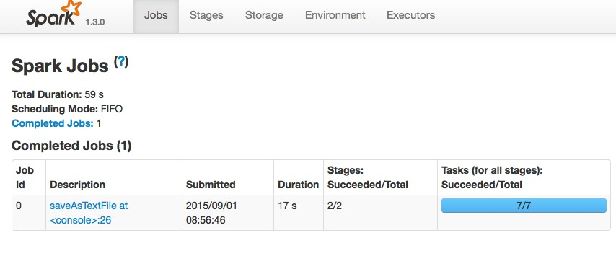



Viewing Stages in the Spark Application UI (1)
You can view jobs and stages in the Spark Application UI
Jobs are identified by the action that triggered the job execution

Slide 95

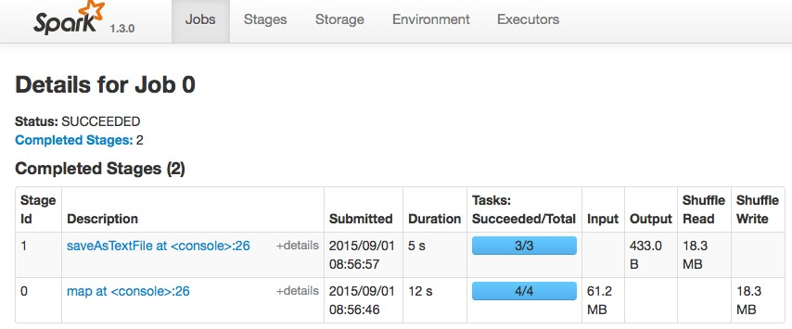









Viewing Stages in the Spark Application UI (2)
Select the job to view execution stages
Stages are identified by the last operation
Number of tasks = number of partitions
Data shuffled between stages

Slide 96
Chapter Topics
Parallel Processing in Spark
Review: Spark on a Cluster
RDD Partitions
Partitioning of File-Based RDDs
HDFS and Data Locality
Executing Parallel Operations
Stages and Tasks
Essential Points
Hands-On Exercise: View Jobs and Stages in the Spark Application UI

Slide 97
Essential Points
RDDs are stored in the memory of Spark executor JVMs
Data is split into partitions – each partition in a separate executor
RDD operations are executed on partitions in parallel
Operations that depend on the same partition are pipelined together in stages
Examples: map, filter
Operations that depend on multiple partitions are executed in separate stages
Examples: join, reduceByKey

Slide 98
Chapter Topics
Parallel Processing in Spark
Review: Spark on a Cluster
RDD Partitions
Partitioning of File-Based RDDs
HDFS and Data Locality
Executing Parallel Operations
Stages and Tasks
Essential Points
Hands-On Exercise: View Jobs and Stages in the Spark Application UI

Slide 99
Hands-On Exercise: View Jobs and Stages in the Spark Application UI
In this Hands-On Exercise, you will use the Spark Application UI to view how jobs, stages and tasks are executed in a job
Please refer to the Hands-On Exercise Manual
16-50

